Slide 1

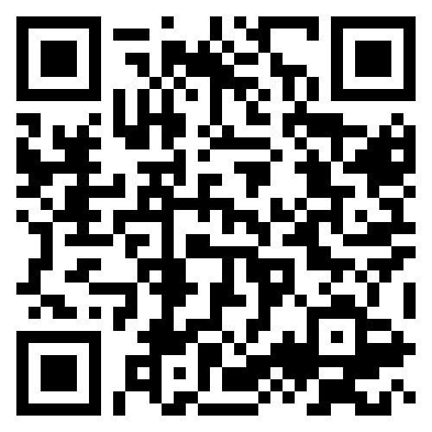
Introduction to KS1
September 2026
Notes:
Jacqui

Slide 2

Meet the Team
Phase Leader: Mrs Akintunde
Year 1
Teachers:
Mrs Akintunde (1A - Jellyfish Class)
Miss Turtle (1T – Whales Class)
LSAs: Mrs Bolt, Mrs Allen, Miss McMahon, Miss Porter
Year 2
Teachers:
Miss Burrowes (2B – Lemurs Class)
Miss Clements (2C - Lion Class)
LSAs: Mrs Harries, Mrs Mowle, Mrs England
Notes:
Jacqui

Slide 3

Key Information
PE DAYS
Our PE days are… Thursday and Friday
LIBRARY
Our library day is… Friday
Every week your child will go to the library to have a chance to pick a book of their choice which interests them. This is a book for you to share with and read to your child.
Your child can only have one library book at a time, so they must return their book before taking out another.
FREE BREAKFAST CLUB
Breakfast club runs from 8am daily and is free to attend with breakfast provided.
You must pre-book if you wish for your child to attend.
LUNCHES
Currently, children in Years R, 1 and 2 can get a hot free meal – choosing from a meat or vegetarian option, a jacket potato with beans, cheese or tuna or tomato pasta. You can pre-order for your children at home!
Packed lunch – your child may bring in a packed lunch from home in a named box or bag. Please pack a healthy packed lunch to suit their appetite and not too much! Any uneaten food will be left in their lunchbox for them to bring home so you know what they have or haven’t eaten.
Please do not send in food containing nuts, peanut butter or any other nut products as we have children with life-threatening allergies. No fizzy drinks, glass bottles, chocolates or sweets are to be brought to school.
Notes:
Sian

Slide 4
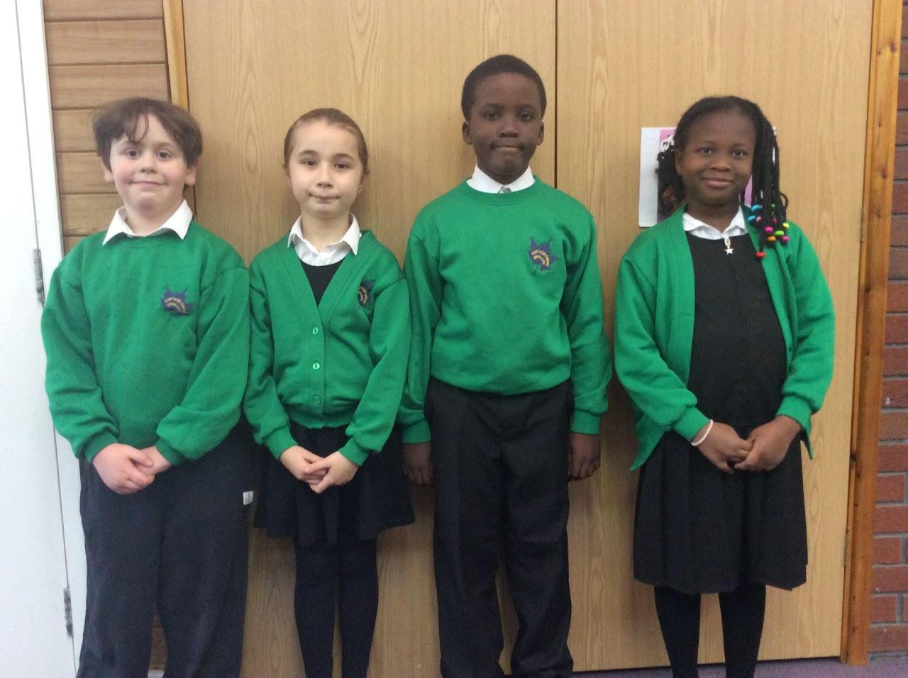

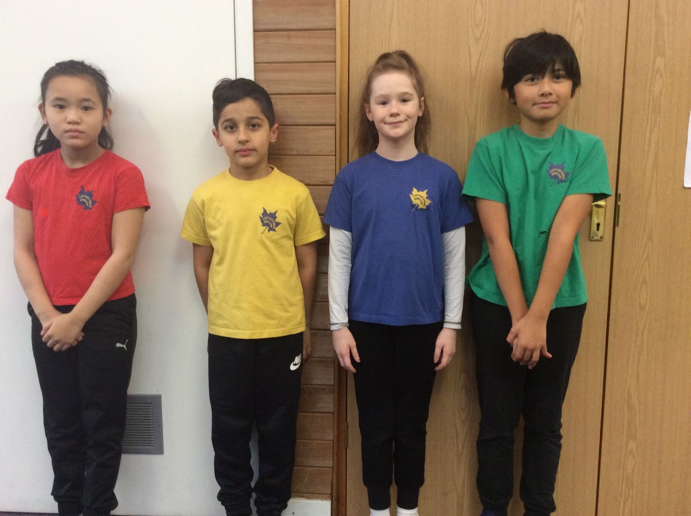
School Uniform
Notes:
Sian

Slide 5
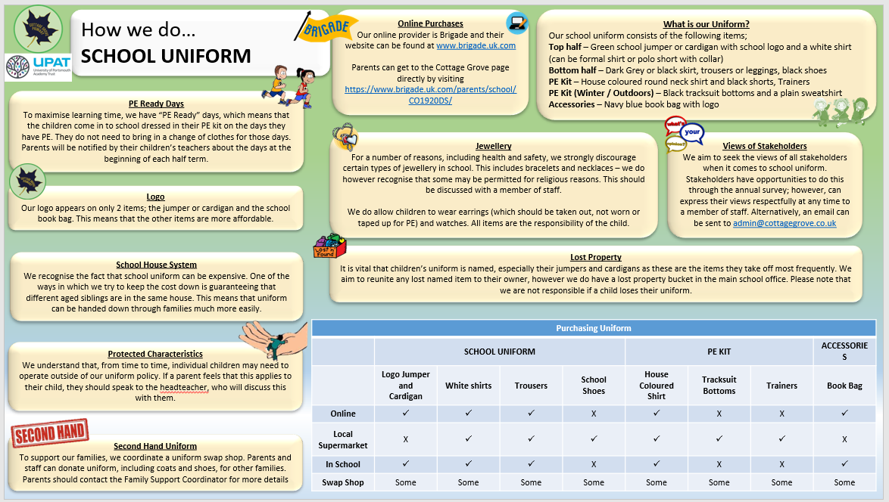
Notes:
Sian

Slide 6

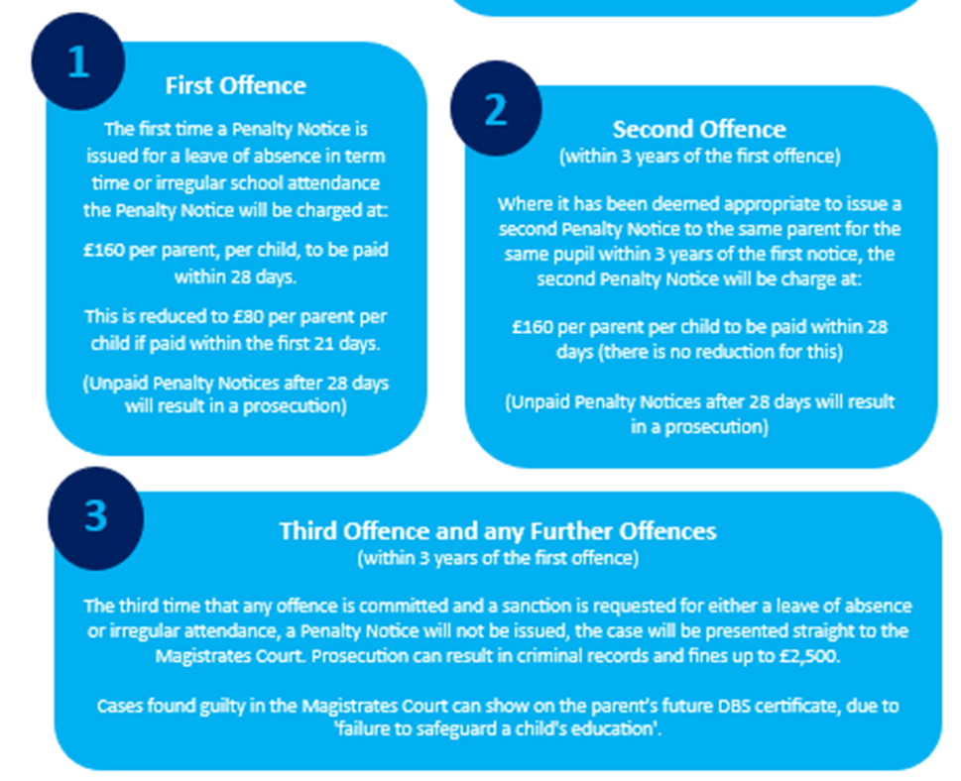
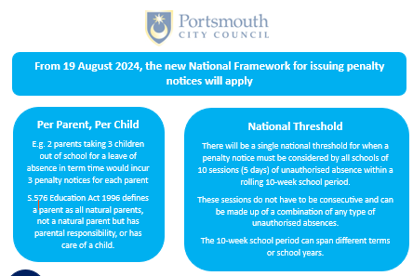
Attendance
Notes:
Lee?

Slide 7



Social Media and Internet Use
Notes:
Kayleigh

Slide 8
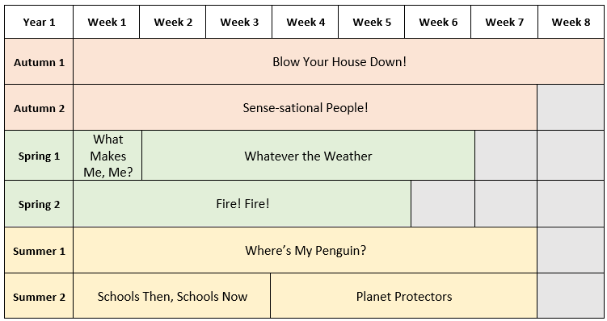
Year 1 Curriculum
Year 1’s assembly
Thursday 6th May 2027
At Cottage Grove, pupils learn through learning journeys. These might last for a week or several weeks.
This is an overview of the topics which will be covered during the year. This is subject to change.
Notes:
Jacqui

Slide 9

Trips and Visits – Year 1
We do our best to minimise the cost of trips and visitors and really appreciate your support in contributing to these. We would not be able to run these trips without your contributions! To help you budget for the year, this is an overview of trips and visits with anticipated costs for the year. This is not an exhaustive list and we will aim to give you as much notice as possible for any extra costs.
Autumn 1: Local walks - £0
Autumn 2: Victoria Park - £0
Spring 1:
Spring 2: Jane the Baker - £6
Summer 1: Blue Reef Aquarium - £8
Summer 2: Portchester Castle - £0
We also aim to invite parents in to school for assemblies and to celebrate the children’s learning in class. Details will be sent out via Arbor.
Notes:
Jacqui

Slide 10
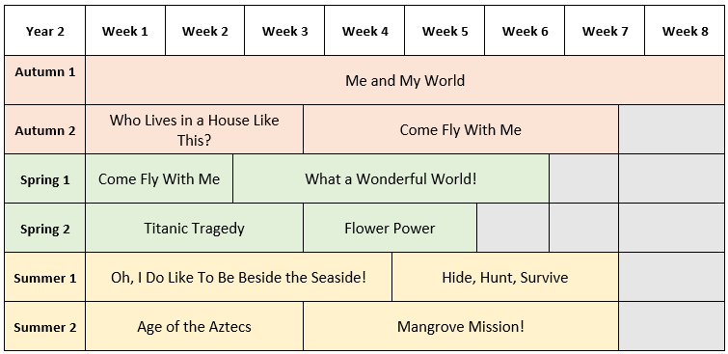
Year 2 Curriculum
Year 2’s assembly
Thursday 15th October 2026
At Cottage Grove, pupils learn through learning journeys. These might last for a week or several weeks.
This is an overview of the topics which will be covered during the year. This is subject to change.
Notes:
Vicky

Slide 11
Trips and Visits – Year 2
We do our best to minimise the cost of trips and visitors and really appreciate your support in contributing to these. We would not be able to run these trips without your contributions! To help you budget for the year, this is an overview of trips and visits with anticipated costs for the year. This is not an exhaustive list and we will aim to give you as much notice as possible for any extra costs.
Autumn 1:
Autumn 2: Fire Service - £0 & Cumberland House £5.00
Spring 1:
Spring 2: Mary Davis (Titanic) in school visit - £8.00
Summer 1: Synagogue - £0
Summer 2:
We also aim to invite parents in to school for assemblies and to celebrate the children’s learning in class. Details will be sent out via Arbor.
Notes:
Vicky

Slide 12
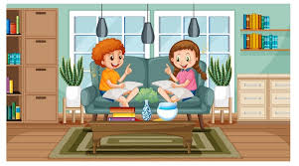


Helping Your Child at Home…
READING
Listening to your child read can take many forms.
Focus developing an enjoyment and love of reading.
Enjoy stories together – reading stories to your child at KS1 and KS2 is equally as important as listening to your child read.
Read a little at a time but often, rather than rarely but for long periods of time!
Talk about the story before, during and afterwards – discuss the plot, the characters, their feelings and actions, how it makes you feel, predict what will happen and encourage your child to have their own opinions.
Look up definitions of words together – you could use a dictionary, the Internet or an app on a phone or tablet.
All reading is valuable – it doesn’t have to be just stories. Reading can involve anything: fiction, non-fiction, poetry, newspapers, magazines, football programmes and TV guides
Visit the local library - it’s free!
WRITING
Practise and learn weekly spelling lists – make it fun by having them “teach you’’.
Encourage opportunities for writing such as letters to family or friends, shopping lists, notes or reminders, stories and poems.
Write together – be a good role model for writing.
Practise handwriting together and discuss the importance of legibility.
Encourage use of a dictionary to check spelling and a thesaurus to expand vocabulary.
Allow your child to use a computer for word processing, which will allow for editing and correcting of errors without lots of crossing out.
Remember that good readers become good writers! Identify good writing features when reading (e.g. vocabulary, sentence structure and punctuation).
MATHS
Practise and learn weekly spelling lists – make it fun by having them “teach you’’.
Encourage opportunities for writing such as letters to family or friends, shopping lists, notes or reminders, stories and poems.
Write together – be a good role model for writing.
Practise handwriting together and discuss the importance of legibility.
Encourage use of a dictionary to check spelling and a thesaurus to expand vocabulary.
Allow your child to use a computer for word processing, which will allow for editing and correcting of errors without lots of crossing out.
Remember that good readers become good writers! Identify good writing features when reading (e.g. vocabulary, sentence structure and punctuation).
Notes:
Kayleigh

Slide 13
Homework
In year 1 and 2, our homework expectations are:
Reading
Children should be reading every night. Once your child has been read with, you can fill in their reading record.
Spelling
Your child will be given spellings to practice at home to reinforce learning in school. Practicing these words at home will help support your child's progress in spelling.
Times Tables:
TTRockstars – in year 2 the children will focus on the 2, 5 and 10 times tables.
Notes:
Kayleigh

Slide 14
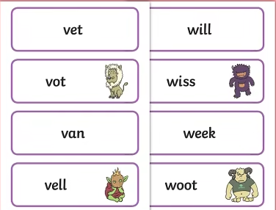


PHONICS SCREENING CHECK
At the end of Year 1, in June 2026, all children will complete a phonics screening check along with those pupils in Year 2 who need to retake the test.
The phonics screening check tests pupils on their ability to apply phonics to read 40 real and nonsense words.
To help support your child to prepare for the phonics screening check please read daily the phonetically decodable book and/or words that are sent home.
Notes:
Jacqui

Slide 15
The whole of the year 1 and 2 team are really looking forward to working with your children this year.
If you have any questions, would like to support as a volunteer reader or would like to support with school trips, please talk to your child’s class teacher or Mrs Akintunde.
Notes:
Jacqui

Slide 16

Notes:
Jacqui

