Slide 1

Introduction to Year 6
September 2027

Slide 2
Meet the Team
Phase Leader: Rachel De La Rue
Year 6
Teachers:
Lorna Fletcher – 6F Falcons
Rosie Cooper(Mon, Tues, Wed) and Amina Khanum (Thurs, Fri) – 6R Phoenix
LSAs: Cath Preston, Kate Raw, Nasrein Eltayeb

Slide 3

Key Information
PE DAY
Our PE day is Wednesday PPA weeks and Monday and Wednesday alternately.
LIBRARY
Our library day is Thursday
Every week your child will go to the library to have a chance to pick a book of their choice which interests them. This is a book for you to share with and read to your child.
Your child can only have one library book at a time, so they must return their book before taking out another.
LUNCHES
Packed lunch – your child may bring in a packed lunch from home in a named box or bag. Please pack a healthy packed lunch to suit their appetite and not too much! Any uneaten food will be left in their lunchbox for them to bring home so you know what they have or haven’t eaten.
Please do not send in food containing nuts, peanut butter or any other nut products as we have children with life-threatening allergies.
No fizzy drinks, glass bottles, chocolates or sweets are to be brought to school.

Slide 4
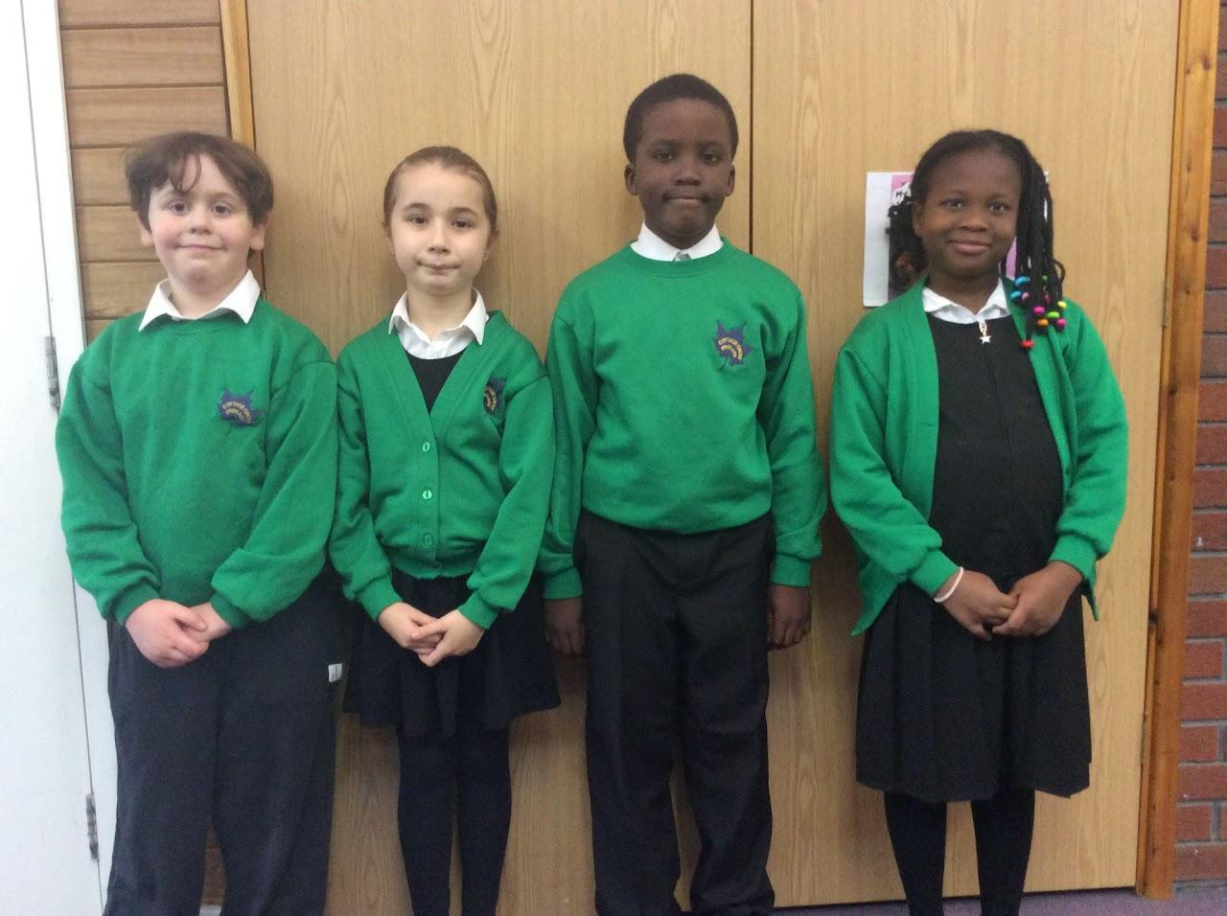

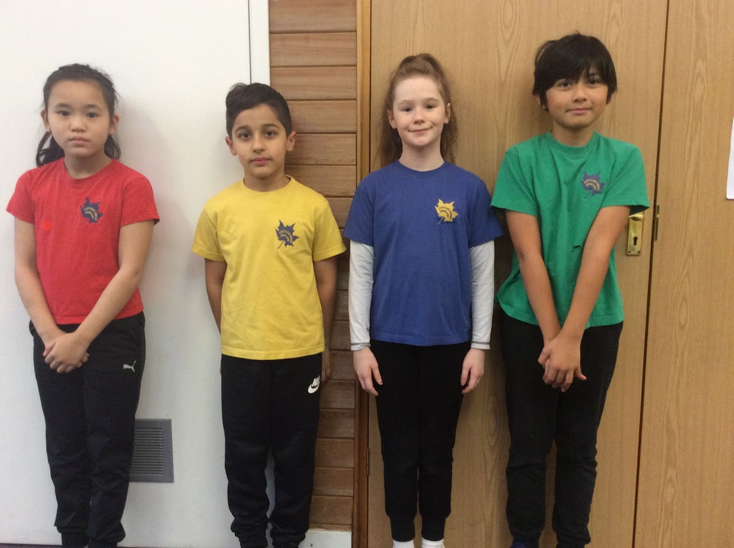
School Uniform

Slide 5
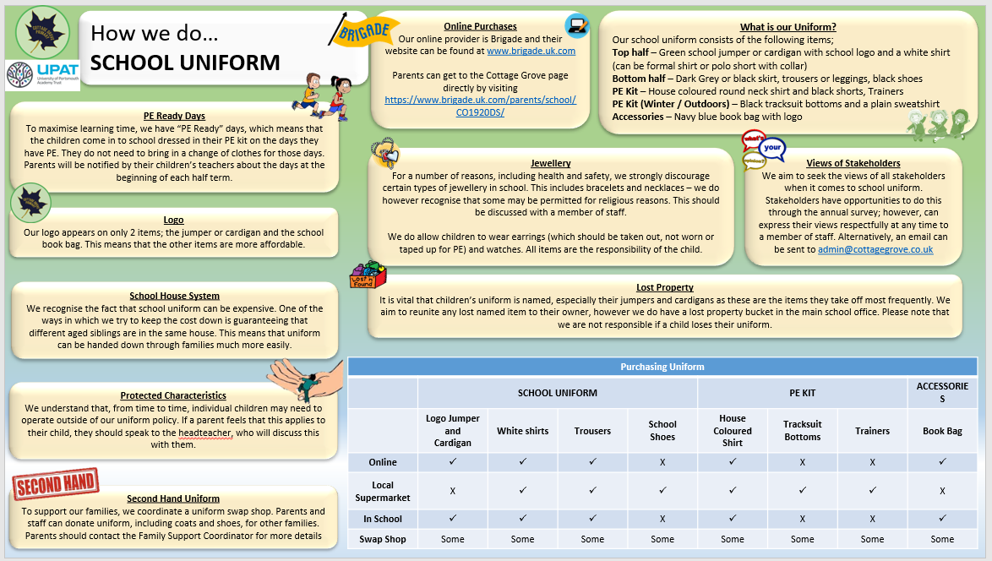

Slide 6

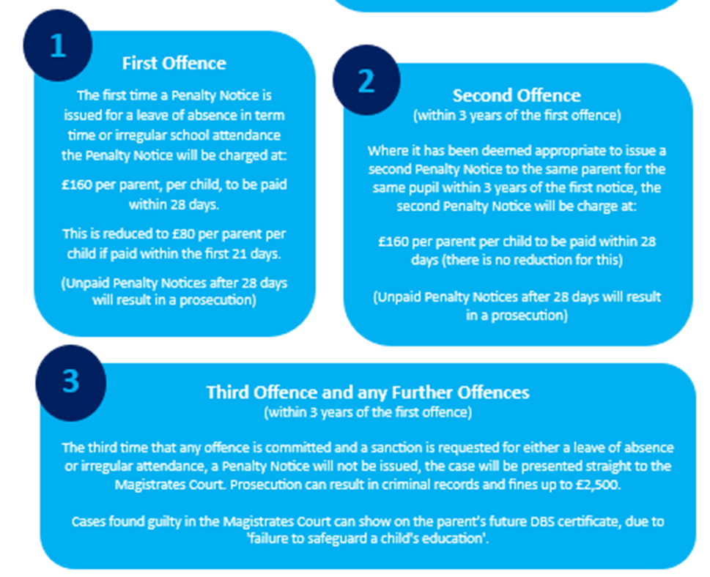
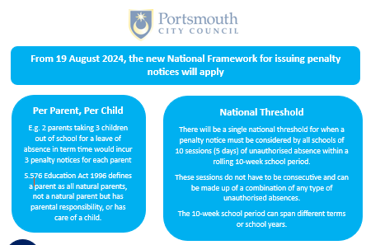
Attendance

Slide 7
Key Information
Change to the start of day
At the beginning of our school day, the teachers will be on the playground to greet their class at 8.40am.
Children are to line up in the playground and wait until the bell sounds to go into class where they will complete their morning tasks.
To give your children the best and most consistent start to their days, we aim for children to be in class and learning by 8.45am
In the event of rain, children can go straight into class when they arrive.
Notes:
Karri

Slide 8

Breakfast Club
Notes:
Lee

Slide 9



Social Media and Internet Use

Slide 10
Year 6 Curriculum
There will be a main learning journey focus, which can last anything from 1 week to a whole half term. The majority of writing, reading and foundation subjects will be taught through this.
Each learning journey will have a particular focus subject such as history or science.
Each learning journey will also involve focus on one main text type which might be fiction or non-fiction.
Maths is taught discretely in most cases, but it will occasionally link to the learning journey.
RE is taught as a mini learning journey – usually at the start or end of a term.
We follow the Destination Reader method for reading. This involves the majority of the session being reading and discussion rather than writing answers to questions and enables children to read more whole texts and not just focus on extracts.

Slide 11
Your child will be involved in many learning journeys and some will be only 1 or two weeks long. These ones are the main ones which last several weeks:
Humans on Earth – geography focus and science focus, writing letters of complaint as an English focus
World War 2 - history focus, narrative writing focus (suspense stories)
The Highwayman - history and geography focus, narrative writing focus and character description
From Holes to Harlem - science and geography focus, non-fiction writing focus (non-chronological reports and recounts)
Polar Planet - science focus, historical recount writing focus

Slide 12

Trips and Visits
We do our best to minimise the cost of trips and visitors and really appreciate your support in contributing to these. We would not be able to run these trips without your contributions! To help you budget for the year, this is an overview of trips and visits with anticipated costs for the year. This is not an exhaustive list and we will aim to give you as much notice as possible for any extra costs.
Autumn 1:
Autumn 2: Fort Nelson World War 2 workshop £3.50 (approximately)
Spring 1: Victoria Park £0
Spring 2: Animals Club £5
Summer 1: Paultons Park £15
Summer 2: Additional end of year trips will cost no more than a further £15.
We also aim to invite parents into school for assemblies and to celebrate the children’s learning in class. Details will be sent out via Arbor.

Slide 13
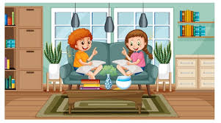


Helping Your Child at Home…
READING
Listening to your child read can take many forms.
Focus developing an enjoyment and love of reading.
Enjoy stories together – reading stories to your child at KS1 and KS2 is equally as important as listening to your child read.
Read a little at a time but often, rather than rarely but for long periods of time!
Talk about the story before, during and afterwards – discuss the plot, the characters, their feelings and actions, how it makes you feel, predict what will happen and encourage your child to have their own opinions.
Look up definitions of words together – you could use a dictionary, the Internet or an app on a phone or tablet.
All reading is valuable – it doesn’t have to be just stories. Reading can involve anything: fiction, non-fiction, poetry, newspapers, magazines, football programmes and TV guides
Visit the local library - it’s free!
WRITING
Practise and learn weekly spelling lists – make it fun by having them “teach you’’.
Encourage opportunities for writing such as letters to family or friends, shopping lists, notes or reminders, stories and poems.
Write together – be a good role model for writing.
Practise handwriting together and discuss the importance of legibility.
Encourage use of a dictionary to check spelling and a thesaurus to expand vocabulary.
Allow your child to use a computer for word processing, which will allow for editing and correcting of errors without lots of crossing out.
Remember that good readers become good writers! Identify good writing features when reading (e.g. vocabulary, sentence structure and punctuation).
MATHS
Play times tables games.
Play mental maths games including counting in different amounts, forwards and backwards.
Encourage opportunities for telling the time.
Encourage opportunities for counting coins and money; finding amounts or calculating change when shopping.
Look for numbers and shapes at home, on street signs, car registrations and anywhere else - have a play with what you can do with them.
Identify, weigh or measure quantities and amounts in the kitchen or in recipes.
Play games involving numbers or logic, such as dominoes, card games, darts, draughts and chess.

Slide 14
Homework
In year 6, our homework expectations are:
Reading
Children should be reading every night. Once your child has been read with, you can fill in their reading record.
Spelling
?
Times Tables:
TTRockstars: your child has a log in for Times Tables Rockstars, which is a fun online site, where they can practice their times tables.
By year 6, children should be familiar with all the multiplication tables up to 12x12 and the corresponding division facts. These facts form the foundation of a lot of our maths work. If your child is not confident with their tables, please encourage them to practice regularly at home.

Slide 15
Secondary School applications
Application for secondary school are made online via the Portsmouth City Council webpage.
The deadline for applications is Saturday 31st October 2026. You will find out which school your child has been allocated on national offer day – 1/3/27.
If you have any problems completing the form, please let us know and we will do our best to help.
We strongly recommended you go and visit the schools you are considering. They will all be having open evenings over the coming weeks. When possible, we will pass these dates on to you, but you can also enquire with schools directly.
Some useful links:
https://www.portsmouth.gov.uk/services/schools-and-learning/schools/admissions/apply-to-move-to-secondary-school/
https://www.portsmouth.gov.uk/services/schools-and-learning/schools/admissions/apply-to-move-to-secondary-school/hints-and-tips-for-secondary-transfer/

Slide 16
KS2 SATs
KS2 Standardised Assessment Tests (SATs) are designed to test you child on the KS2 curriculum – years 3-6. All children around the country will sit their SATs during the same week in May next year.
SATs week is 10th May 2027 and children will take tests in reading, grammar, punctuation and spelling and maths.
Maths is divided into an arithmetic paper and 2 reasoning papers.
Writing is assessed by teachers based on independent work produced in class.
We do not want children to worry about SATs! We will do plenty of practice throughout the year of the style of questions they will encounter, so they will be well-prepared by May.
We have high expectations of all children, but all children progress at their own pace and we will tailor your child’s learning to their needs. SATs is not just about passing the test, but about celebrating the progress your child has made throughout their time at Cottage Grove!#
If you would like to do additional work at home, the CGP workbooks are good. There are also plenty of online resources you can use.

Slide 17


