Slide 1

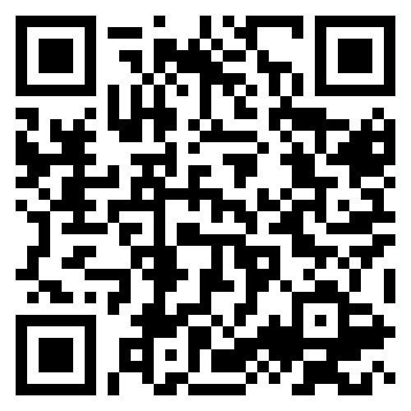
Introduction to Y5
September 2026

Slide 2

Meet the Team
Phase Leader: Mrs De La Rue
Year 5
Teachers:
Mr Watts (5W)
Miss Garner (5G)
LSAs:
Mrs Smith
Mrs Bremer

Slide 3

Key Information
PE DAYS
Our PE day is Wednesday.
Swimming is on a Thursday for all of Autumn term.
Please ensure your child has the correct swimming kit and label all items where possible.
LIBRARY
Our library day is Thursday.
Every week your child will go to the library to have a chance to pick a book of their choice which interests them. This is a book for you to share with and read to your child. Your child can only have one library book at a time, so they must return their book before taking out another.
LUNCHES
Packed lunch – your child may bring in a packed lunch from home in a named box or bag. Please pack a healthy packed lunch to suit their appetite and not too much! Any uneaten food will be left in their lunchbox for them to bring home so you know what they have or haven’t eaten.
Please do not send in food containing nuts, peanut butter or any other nut products as we have children with life-threatening allergies. No fizzy drinks, glass bottles, chocolates or sweets are to be brought to school.

Slide 4
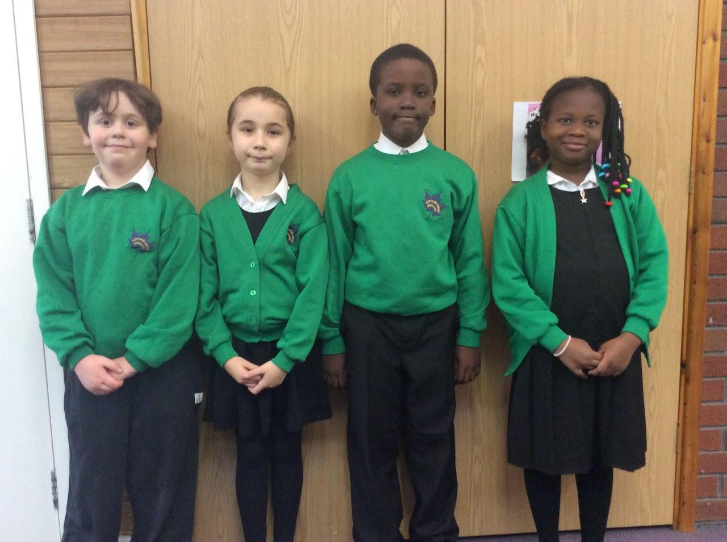

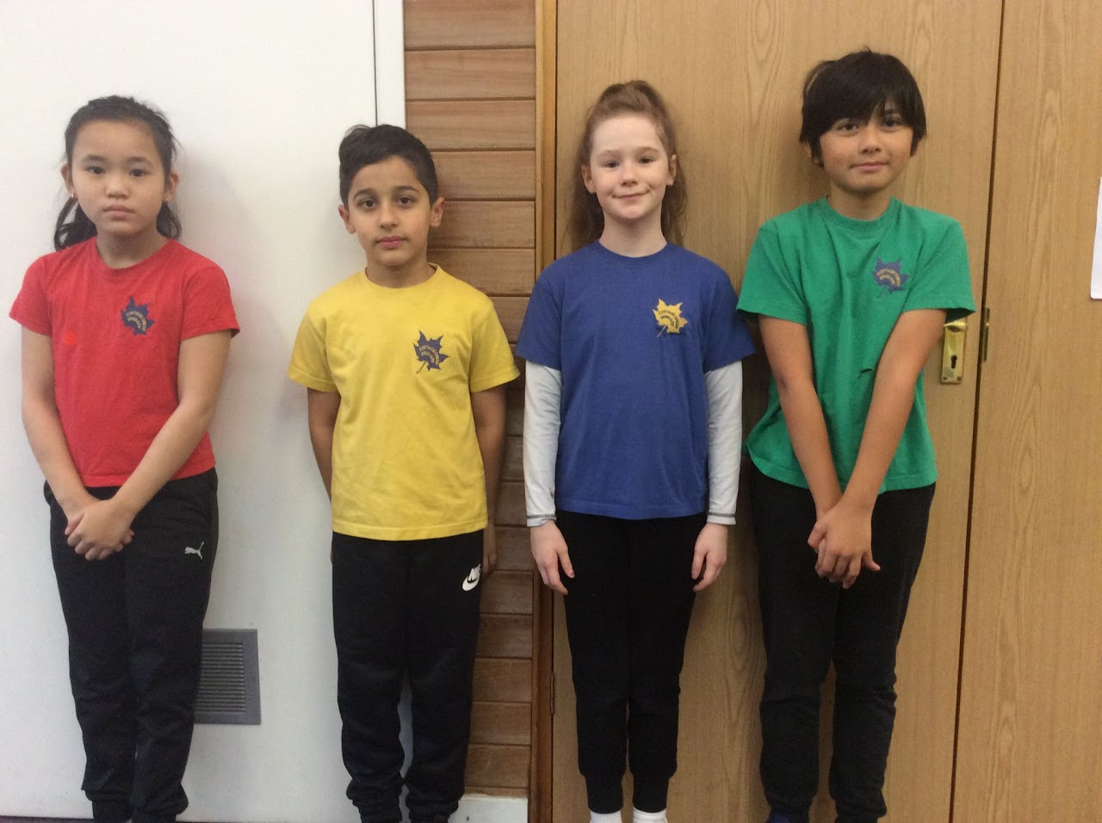
School Uniform

Slide 5
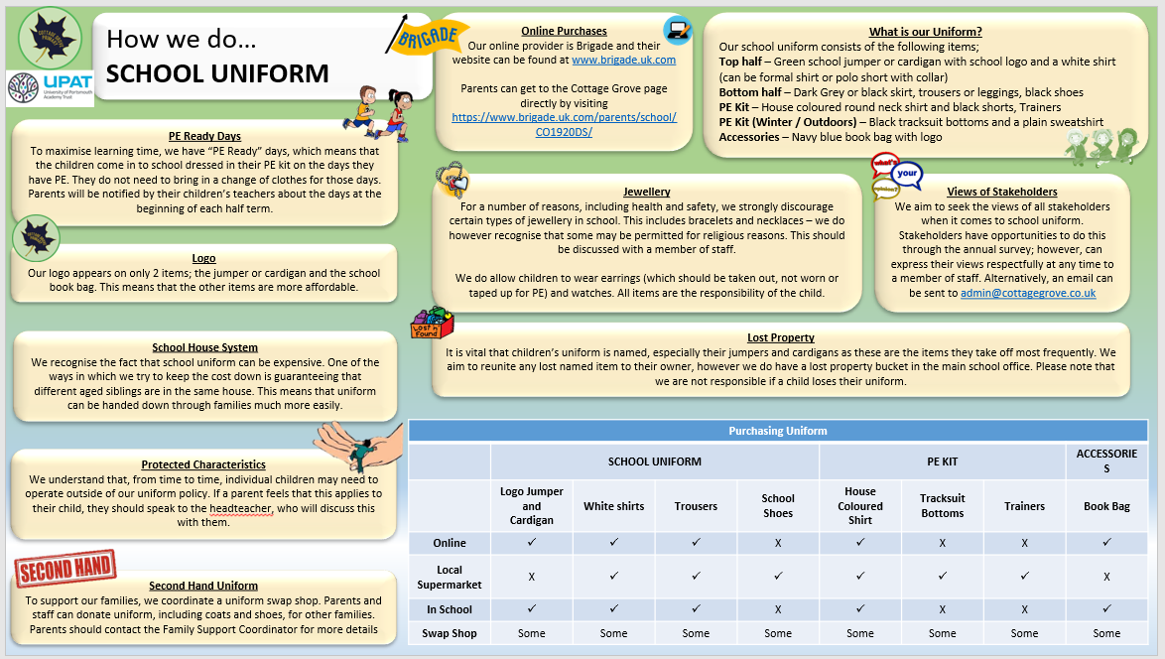

Slide 6

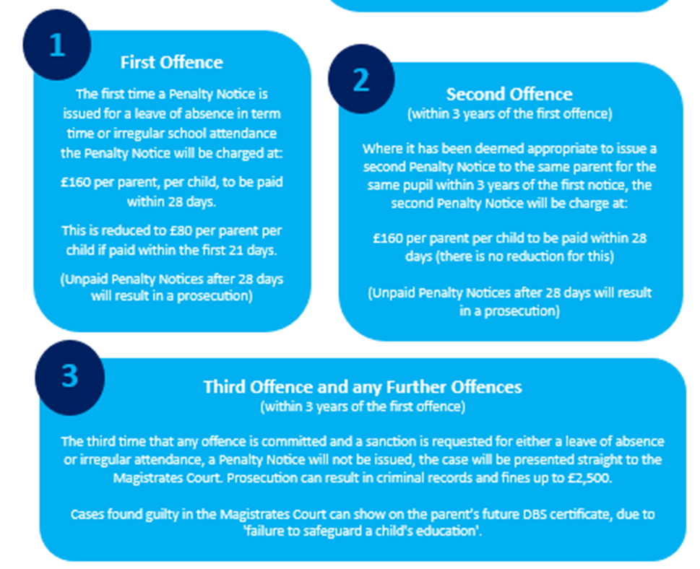
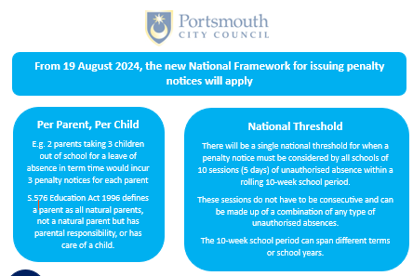
Attendance

Slide 7



Social Media and Internet Use

Slide 8
Year 5 Curriculum

Slide 9

Trips and Visits

Slide 10
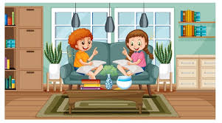
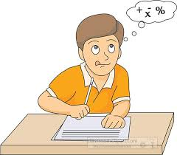
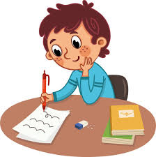
Helping Your Child at Home…
READING
Listening to your child read can take many forms.
Focus developing an enjoyment and love of reading.
Enjoy stories together – reading stories to your child at KS1 and KS2 is equally as important as listening to your child read.
Read a little at a time but often, rather than rarely but for long periods of time!
Talk about the story before, during and afterwards – discuss the plot, the characters, their feelings and actions, how it makes you feel, predict what will happen and encourage your child to have their own opinions.
Look up definitions of words together – you could use a dictionary, the Internet or an app on a phone or tablet.
All reading is valuable – it doesn’t have to be just stories. Reading can involve anything: fiction, non-fiction, poetry, newspapers, magazines, football programmes and TV guides
Visit the local library - it’s free!
WRITING
Practise and learn weekly spelling lists – make it fun by having them “teach you’’.
Encourage opportunities for writing such as letters to family or friends, shopping lists, notes or reminders, stories and poems.
Write together – be a good role model for writing.
Practise handwriting together and discuss the importance of legibility.
Encourage use of a dictionary to check spelling and a thesaurus to expand vocabulary.
Allow your child to use a computer for word processing, which will allow for editing and correcting of errors without lots of crossing out.
Remember that good readers become good writers! Identify good writing features when reading (e.g. vocabulary, sentence structure and punctuation).
MATHS
Play times tables games.
Play mental maths games including counting in different amounts, forwards and backwards.
Encourage opportunities for telling the time.
Encourage opportunities for counting coins and money; finding amounts or calculating change when shopping.
Look for numbers and shapes at home, on street signs, car registrations and anywhere else - have a play with what you can do with them.
Identify, weigh or measure quantities and amounts in the kitchen or in recipes.
Play games involving numbers or logic, such as dominoes, card games, darts, draughts and chess.

Slide 11
Homework
In year 5, our homework expectations are:
Reading
Children should be reading every night. Once your child has been read with, you can fill in their reading record.
Spelling
Each week the children will be sent home with a set of words which they will need to learn. Practicing these words at home will support your child's progress in spelling. They will have a spelling test every half term on a selection of the words.
Times Tables:
TTRockstars is still available for children to access from home. In school, we will be consolidating the children’s timetables knowledge through a programme called Number Sense. Please encourage your child to continue to practise regularly at home to support their number fact recall speed and fluency as this supports all areas of their maths learning.

Slide 12


Year Group Specifics
The Y5 curriculum is packed with lots of exciting new learning – please encourage your child to share what we’ve been doing in class.
We are placing a big focus on presentation and pride in our work, especially neat and consistent handwriting.
Our key aim is for every child to love learning – we will make lessons as engaging, creative and enjoyable as possible.
All we ask is that children come to school ready to learn, full of enthusiasm, and willing to give their best effort and attention each day.

Slide 13


