Slide 1

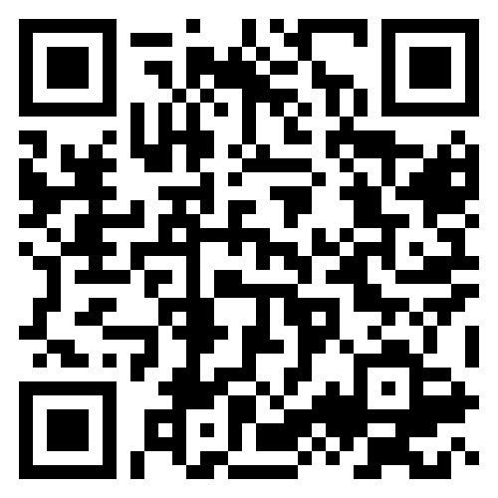
Introduction to Y3 and Y4
September 2026

Slide 2
Meet the Team
Phase Leader: Mrs De La Rue
Year 3
Teachers:
Mrs Begum (3B- Leopard class)
Miss Crocker (3C- Red Panda class)
LSAs: Mrs Jobber, Ms Spreadbury, Mrs Morley
Year 4
Teachers:
Mr Patrick (4P – Alpacas class)
Mr Cusack (4C – Panthers class)
LSAs: Mrs Ahmed, Mrs Miah

Slide 3

Key Information
PE DAYS
In Years 3 and 4 our PE day is Tuesday.
LIBRARY
Our library day in year 3 is Monday
Our library day in year 4 is Wednesday
Every week your child will go to the library to have a chance to pick a book of their choice which interests them. This is a book for you to share with and read to your child.
Your child can only have one library book at a time, so they must return their book before taking out another.
LUNCHES
Packed lunch – your child may bring in a packed lunch from home in a named box or bag. Please pack a healthy packed lunch to suit their appetite and not too much! Any uneaten food will be left in their lunchbox for them to bring home so you know what they have or haven’t eaten.
Please do not send in food containing nuts, peanut butter or any other nut products as we have children with life-threatening allergies.
No fizzy drinks, glass bottles, chocolates or sweets are to be brought to school.
Notes:
Fahima and Alex

Slide 4
Key Information
Change to the start of day
At the beginning of our school day, the teachers will be on the playground to greet their class at 8.40am.
Children are to line up in the playground and wait until the bell sounds to go into class where they will complete their morning tasks.
To give your children the best and most consistent start to their days, we aim for children to be in class and learning by 8.45am
In the event of rain, children can go straight into class when they arrive.
Notes:
Karri

Slide 5
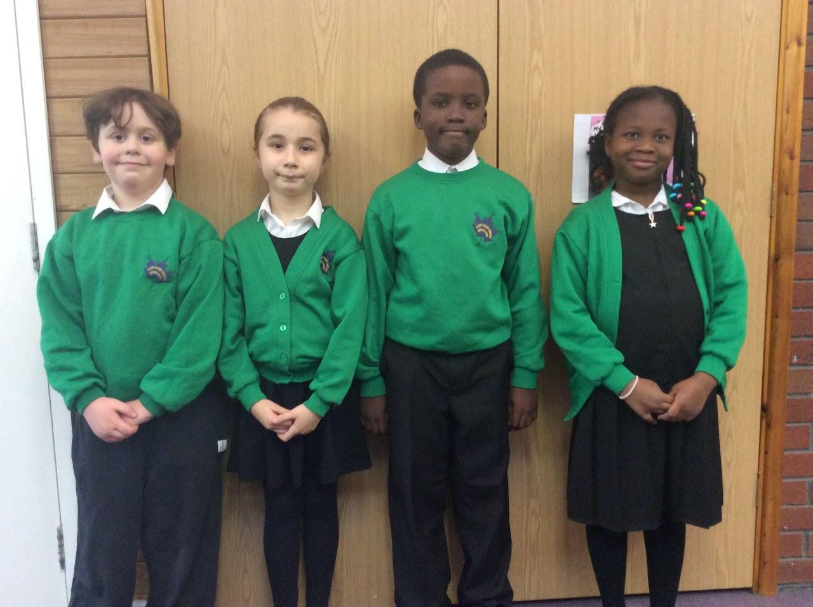

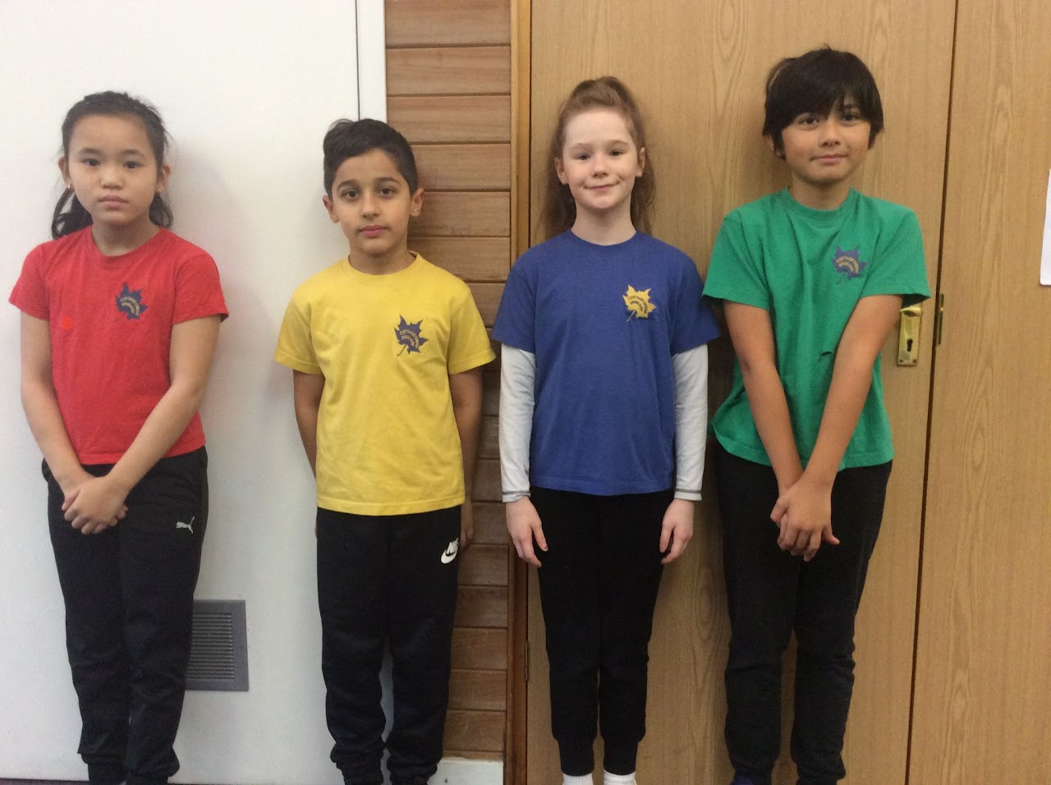
School Uniform
Notes:
Karri

Slide 6
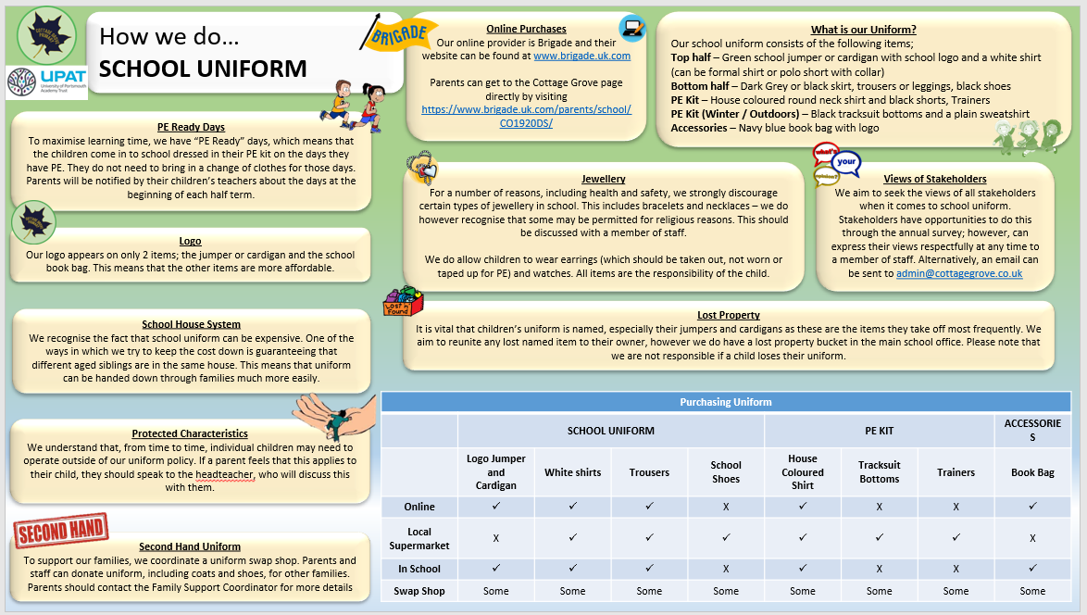
Notes:
Lee

Slide 7

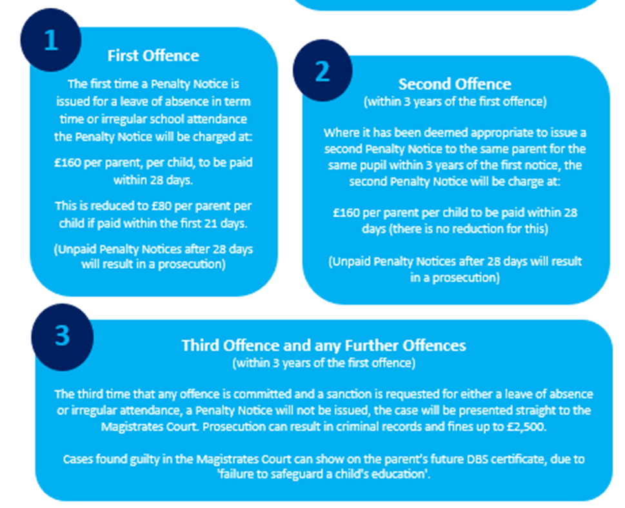
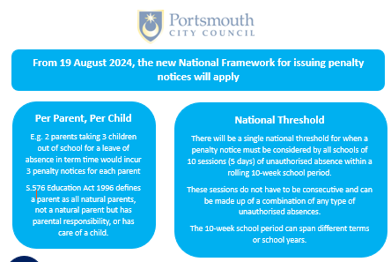
Attendance
Notes:
Lee

Slide 8

Breakfast Club
Notes:
Lee

Slide 9



Social Media and Internet Use
Notes:
Karri

Slide 10
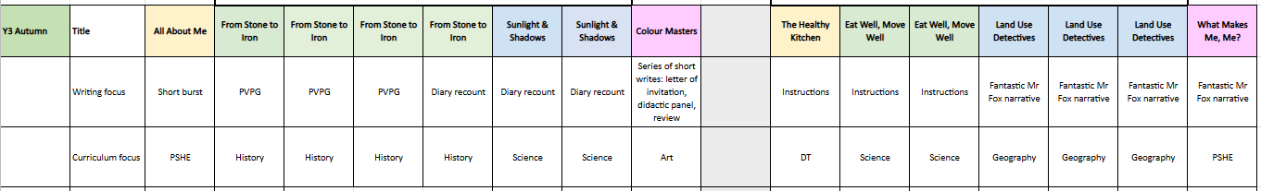
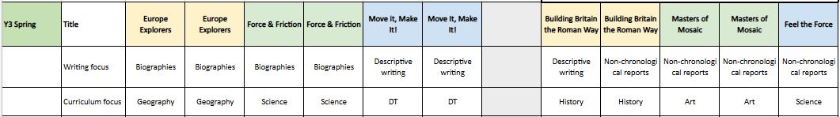
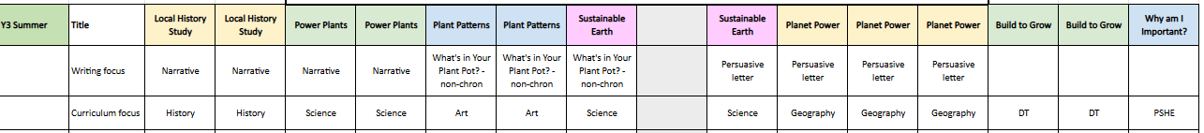
Year 3 Curriculum
Notes:
Karri

Slide 11
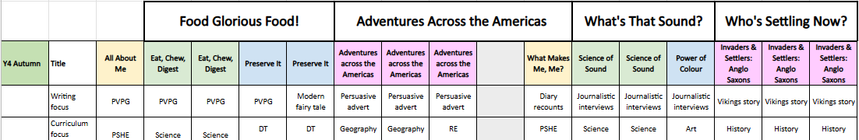
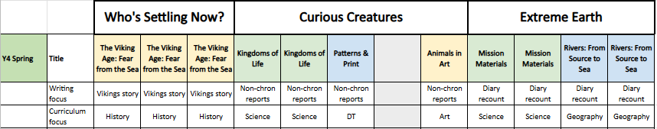
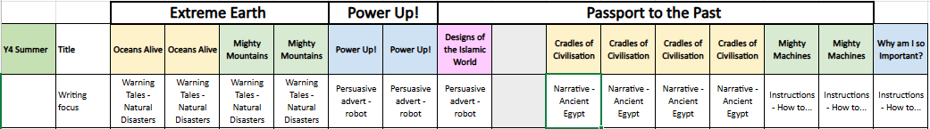
Year 4 Curriculum
Notes:
Robbie

Slide 12

Y3 Trips and Visits
We do our best to minimise the cost of trips and visitors and really appreciate your support in contributing to these. We would not be able to run these trips without your contributions! To help you budget for the year, this is an overview of trips and visits with anticipated costs for the year. This is not an exhaustive list and we will aim to give you as much notice as possible for any extra costs.
Autumn 1: Butser Ancient farm
Autumn 2: Dockyards (Celebrating 100 years) +
Spring 1: Friction + Forces workshop
Spring 2: Fort Nelson
Summer 1: Rock garden
Summer 2: Science workshop
Total cost for all the trips: £22.50
We also aim to invite parents into school for assemblies and to celebrate the children’s learning in class. Details will be sent out via Arbor.
Notes:
Fahima and Lee

Slide 13
Y4 Trips and Visits
We do our best to minimise the cost of trips and visitors and really appreciate your support in contributing to these. We would not be able to run these trips without your contributions! To help you budget for the year, this is an overview of trips and visits with anticipated costs for the year. This is not an exhaustive list and we will aim to give you as much notice as possible for any extra costs.
Autumn 1: Digestive System Workshop
Autumn 2: Anglo Saxons Workshop
Spring 1: Stubbington Residential* and Marwell Zoo
Spring 2: River Field Trip
Summer 1: Cathedral Trip
Summer 2: Egyptian Workshop
Total cost for the year: £21.30 (excluding Stubbington Residential)
We also aim to invite parents into school for assemblies and to celebrate the children’s learning in class. Details will be sent out via Arbor.
Notes:
Robbie

Slide 14
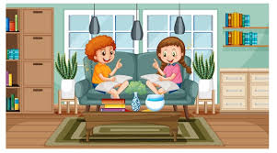

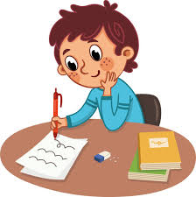
Helping Your Child at Home…
READING
Listening to your child read can take many forms.
Focus developing an enjoyment and love of reading.
Enjoy stories together – reading stories to your child at KS1 and KS2 is equally as important as listening to your child read.
Read a little at a time but often, rather than rarely but for long periods of time!
Talk about the story before, during and afterwards – discuss the plot, the characters, their feelings and actions, how it makes you feel, predict what will happen and encourage your child to have their own opinions.
Look up definitions of words together – you could use a dictionary, the Internet or an app on a phone or tablet.
All reading is valuable – it doesn’t have to be just stories. Reading can involve anything: fiction, non-fiction, poetry, newspapers, magazines, football programmes and TV guides
Visit the local library - it’s free!
WRITING
Practise and learn weekly spelling lists – make it fun by having them “teach you’’.
Encourage opportunities for writing such as letters to family or friends, shopping lists, notes or reminders, stories and poems.
Write together – be a good role model for writing.
Practise handwriting together and discuss the importance of legibility.
Encourage use of a dictionary to check spelling and a thesaurus to expand vocabulary.
Allow your child to use a computer for word processing, which will allow for editing and correcting of errors without lots of crossing out.
Remember that good readers become good writers! Identify good writing features when reading (e.g. vocabulary, sentence structure and punctuation).
MATHS
Play times tables games.
Play mental maths games including counting in different amounts, forwards and backwards.
Encourage opportunities for telling the time.
Encourage opportunities for counting coins and money; finding amounts or calculating change when shopping.
Look for numbers and shapes at home, on street signs, car registrations and anywhere else - have a play with what you can do with them.
Identify, weigh or measure quantities and amounts in the kitchen or in recipes.
Play games involving numbers or logic, such as dominoes, card games, darts, draughts and chess.
Notes:
Fahima and Karri

Slide 15
Homework
In year 3 and 4, our homework expectations are:
Reading
Children should be reading every night. Once your child has been read with, you can fill in their reading record.
Spelling
Every half term the children will do a spelling test. Each week the children will be sent home with a set of words which they can practise in preparation for this.
Times Tables:
TTRockstars
In year 3, they will progress through the 3, 4 and 8’s.
By the end of year 4 children should know all of their times table facts.
Notes:
Alex

Slide 16
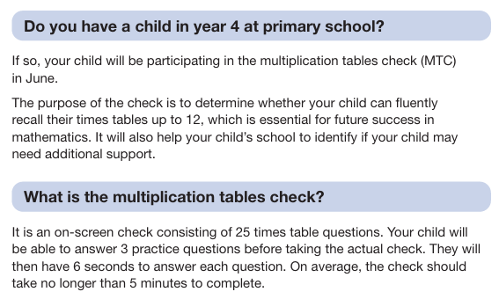
Year 4 Specifics
MTC checks
Notes:
Robbie

Slide 17


